Slide 1



RSI and Performance
Ian McElveen and Cecilia Gonzales

Slide 2
Are changes in RSI related to team game performance?

Slide 3
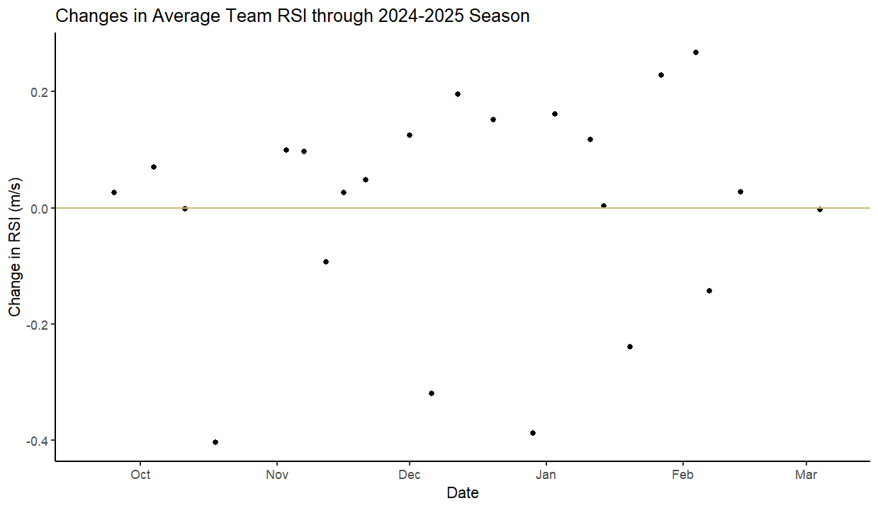
Team Performance
Notes:
Establishing baselines
Doubled tests performed

Slide 4
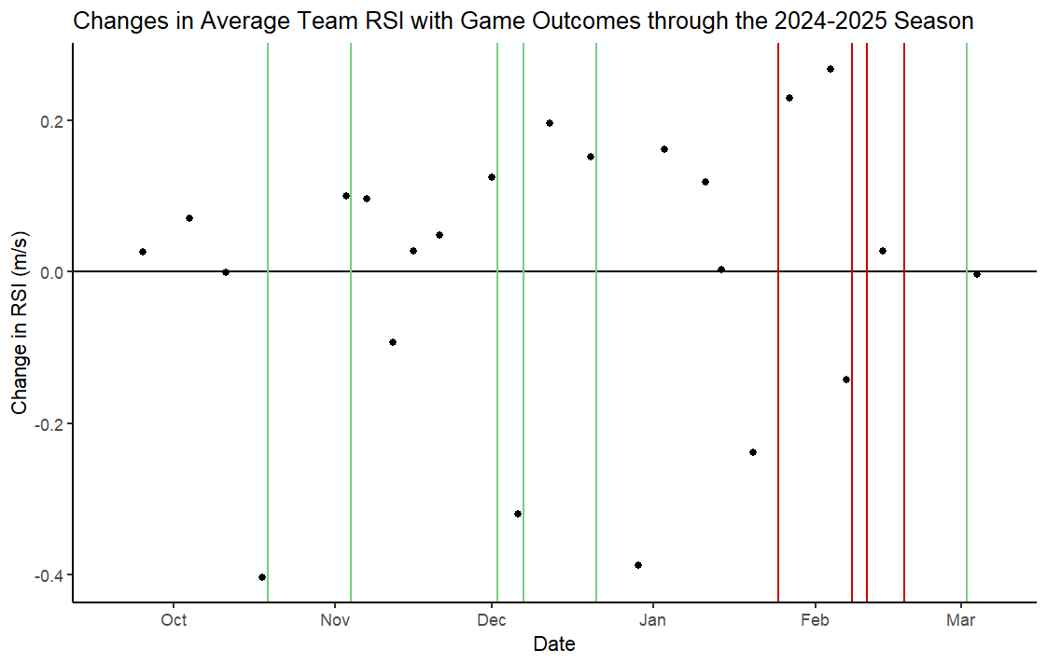
Team Performance
Match Day-1 Reactive Strength Index and In-Game Peak Speed in Collegiate Division I Basketball by Adam Petway
Notes:
Establishing baselines
Doubled tests performed

Slide 5
Model Results
Team Performance
Predicting Above Median Game Performance
Can't be used to reliably predict team game performance Future analysis focus on lowering threshold to be considered above median Not frequent enough data to mimic past research
Predicting Below Median Game Performance
Can predict below median team game performance to certain degree Had to lower classification threshold to get accurate predictions (not sensitive) Lower threshold to be considered below median, look only at one statistic at a time Not frequent enough data to mimic past research

Slide 6
Are changes in RSI related to individual statistic game performance?

Slide 7
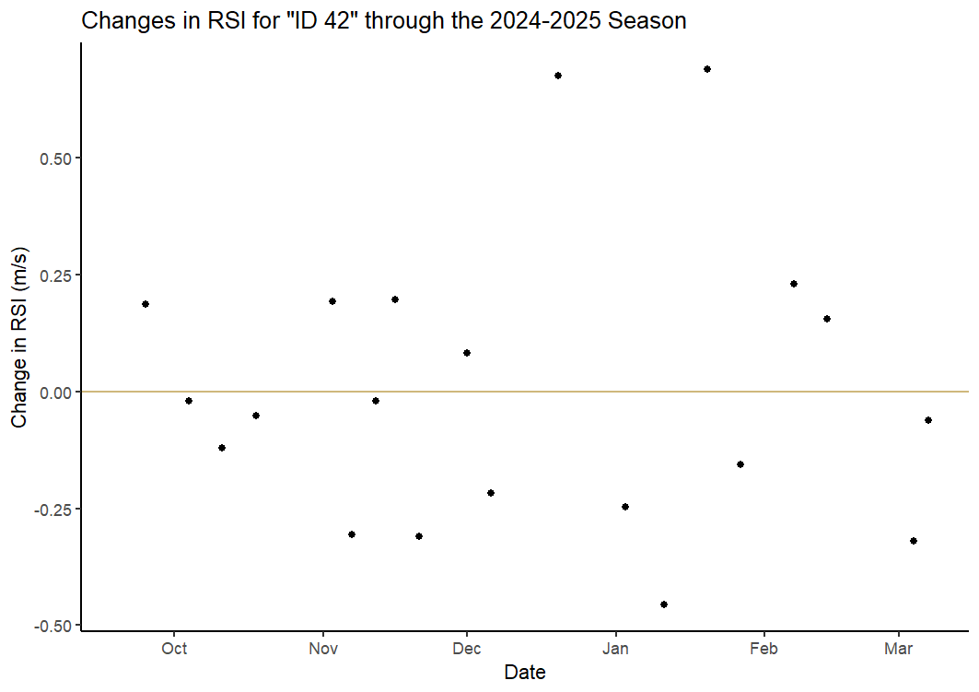
Individual Performance

Slide 8
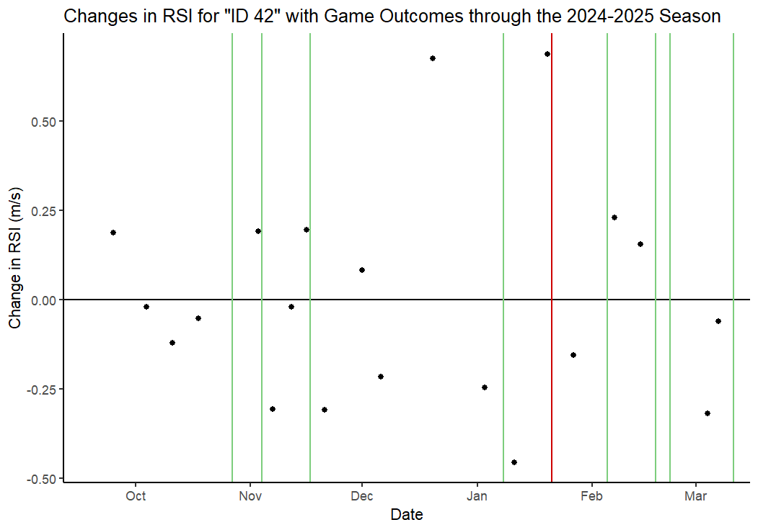
Individual Performance

Slide 9
Pooled Model Results
Individual Performance
Predicting Above Median Game Performance
RSI has a somewhat strong relationship with above median in game performance High threshold for success may influence higher false discovery rate
Predicting Below Median Game Performance
RSI has somewhat weak relationship with below median in game performance Very high false discovery rate meaning it over predicts the prevalence of below median games Low threshold to have "success" meaning RSI is not sensitive enough to make strong predictions for a below median game

Slide 10
Unpooled Model Results
Individual Performance
Predicting Above Median Game Performance
Using players individually improves the model's power to correctly identify games that are above median Implies that some players have stronger relationships between RSI and in game performance than others
Predicting Below Median Game Performance
Using players individually improved the model's ability to identify games that were below median Lowered threshold to be considered below median, RSI not a strong predictor for below median in game performance

Slide 11
Is the previous week's load related to RSI?

Slide 12
Previous Load
Load Window | Days Included | Metrics Calculated
7-Day | Test day and the 6 days before | Average Acceleration Load Average Jump Load
3-Day | Test day and the 2 days before | Average Acceleration Load Average Jump Load
2-Day | Test day and the day before | Average Acceleration Load Average Jump Load
Notes:
Establishing baselines
Doubled tests performed

Slide 13
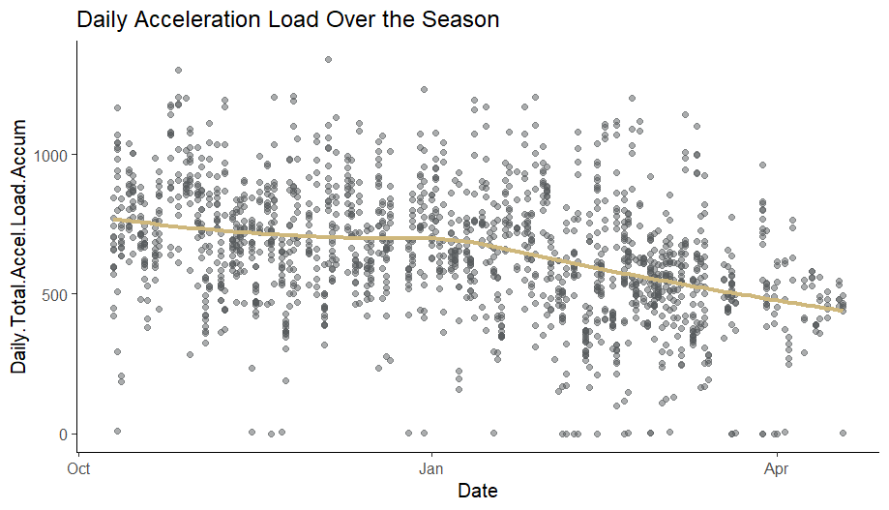
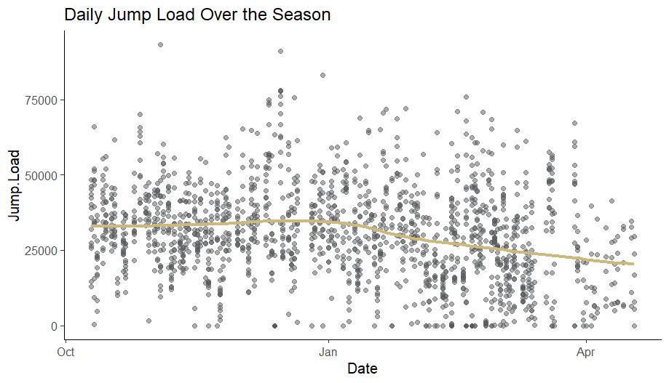
Previous Load
Notes:
Establishing baselines
Doubled tests performed

Slide 14
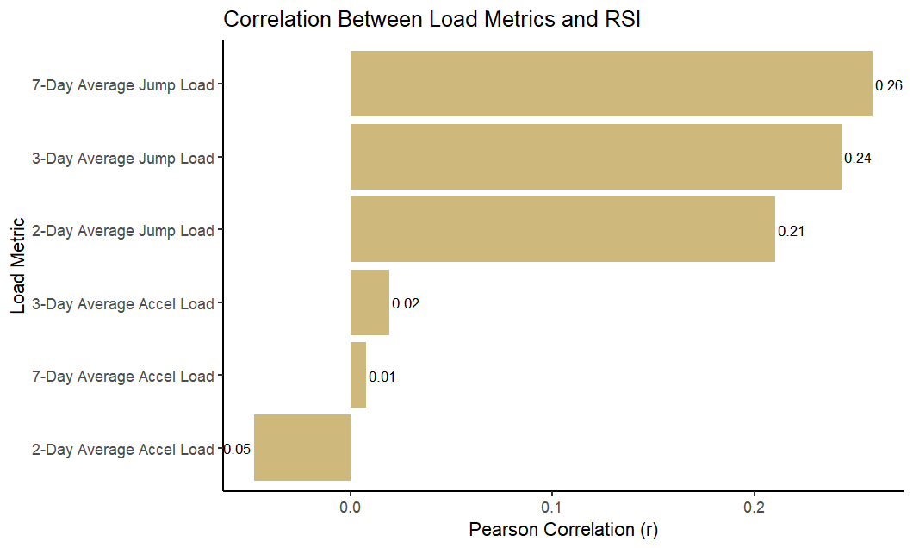
Previous Load
Notes:
Establishing baselines
Doubled tests performed

Slide 15
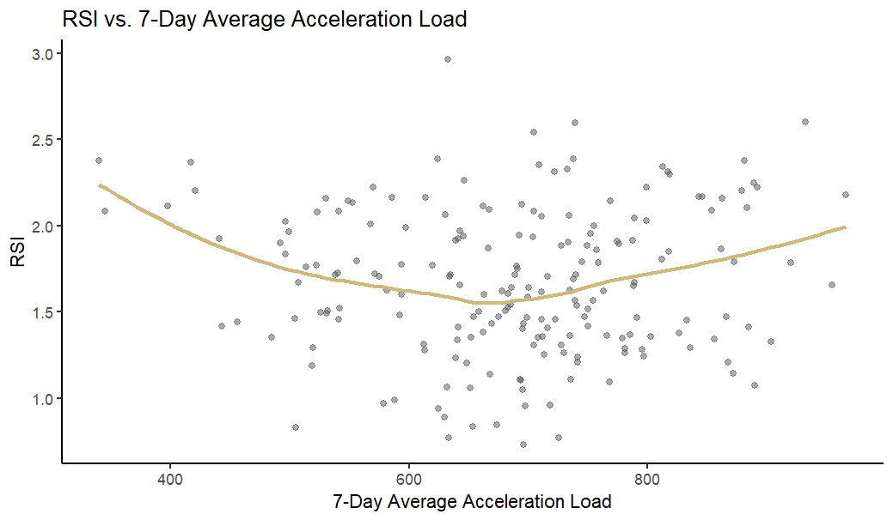
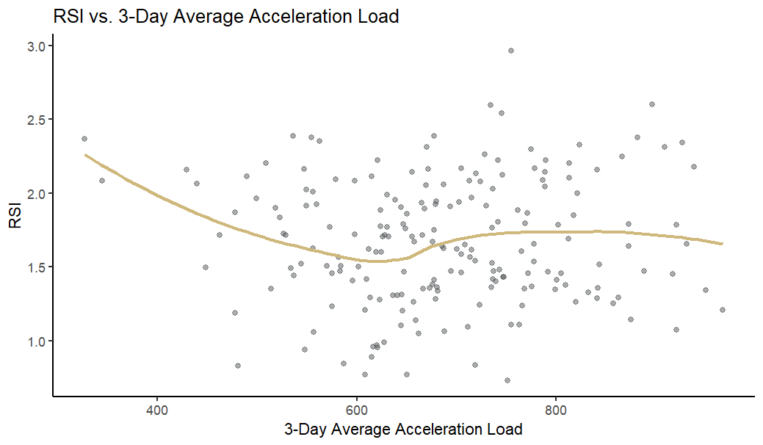
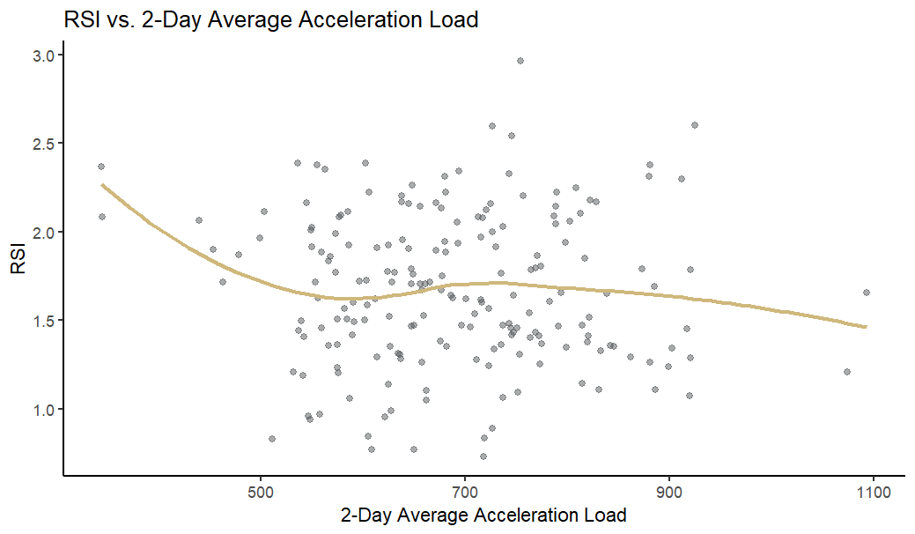
Acceleration Load
Previous Load
Notes:
Establishing baselines
Doubled tests performed

Slide 16
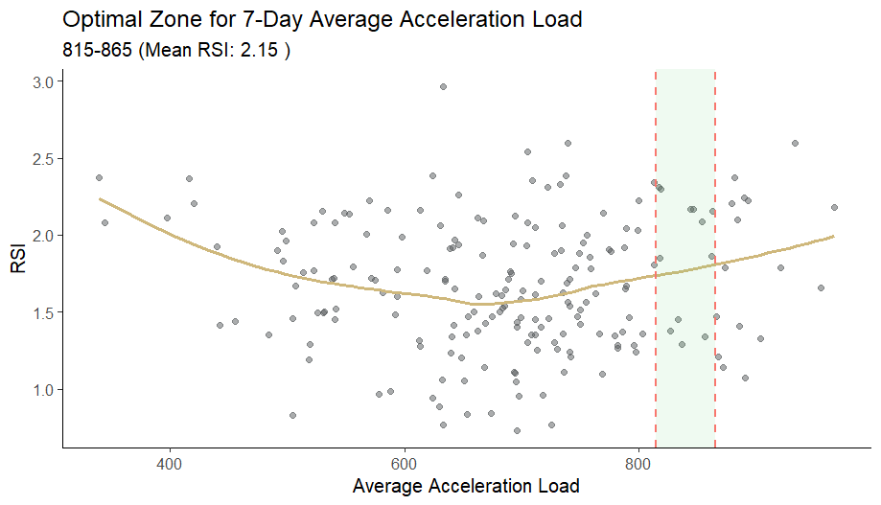
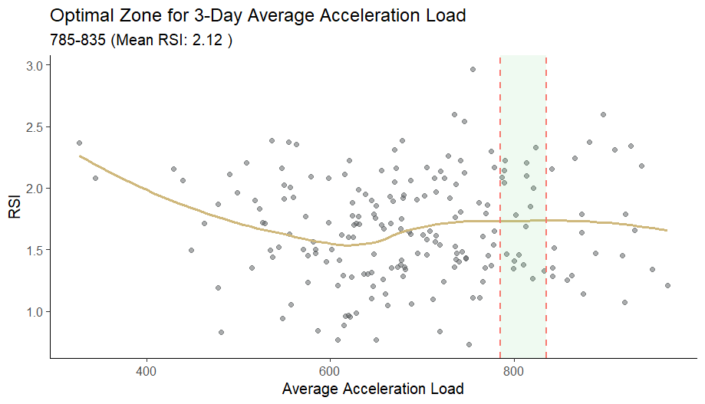
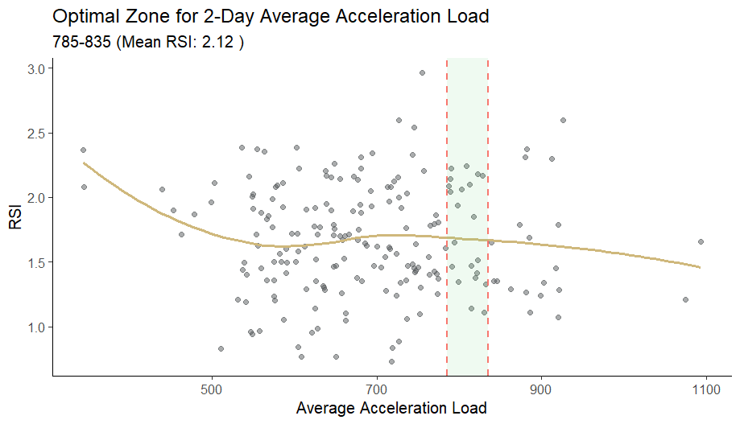
Acceleration Load
Previous Load
Notes:
Establishing baselines
Doubled tests performed

Slide 17
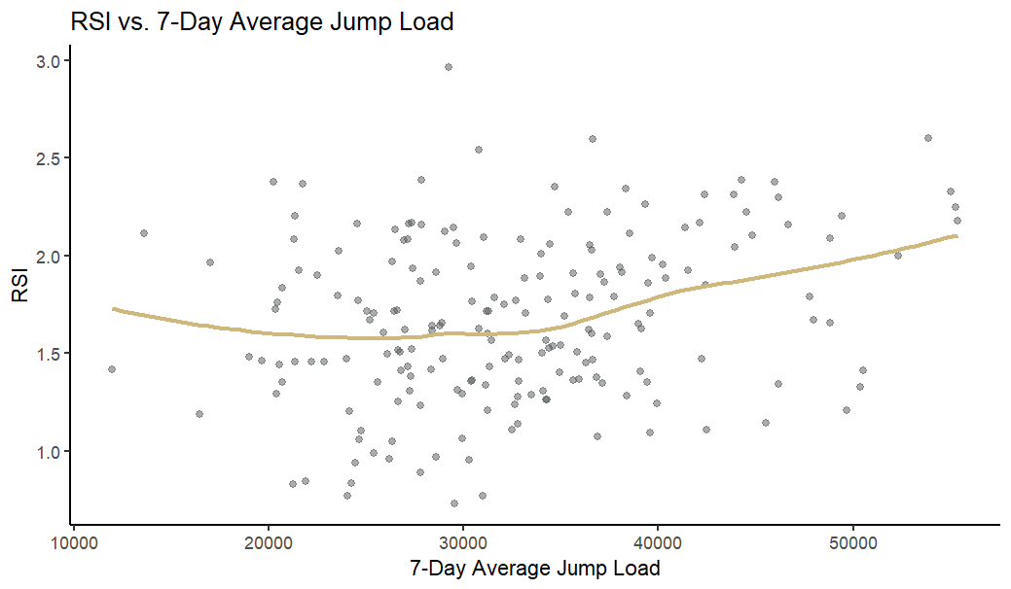
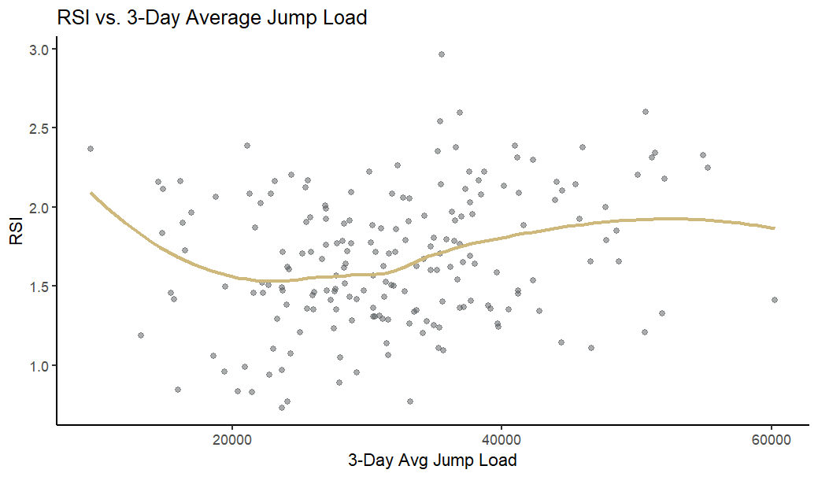
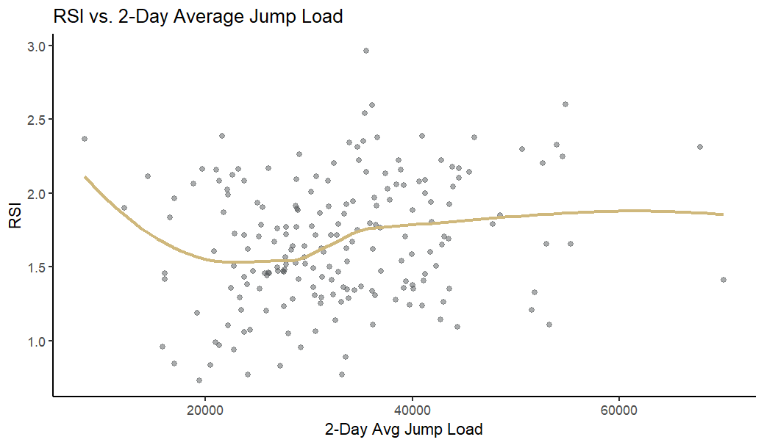
Jump Load
Previous Load
Notes:
Establishing baselines
Doubled tests performed

Slide 18
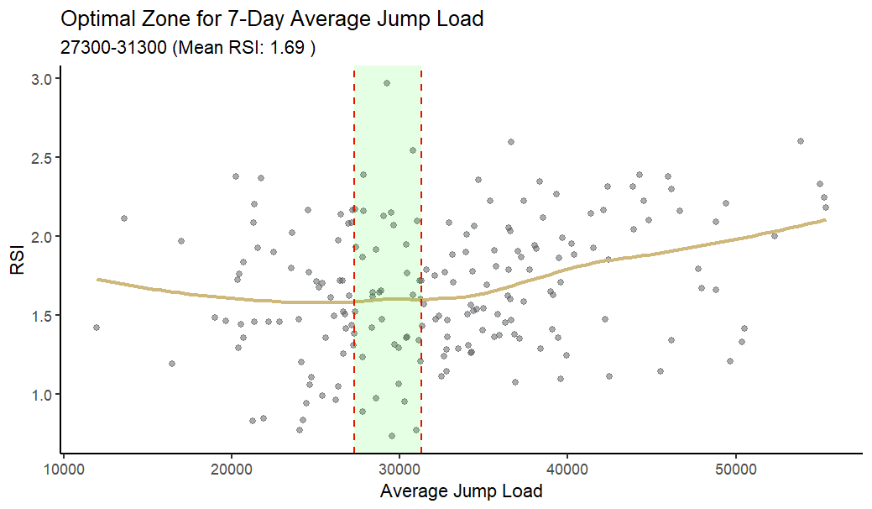
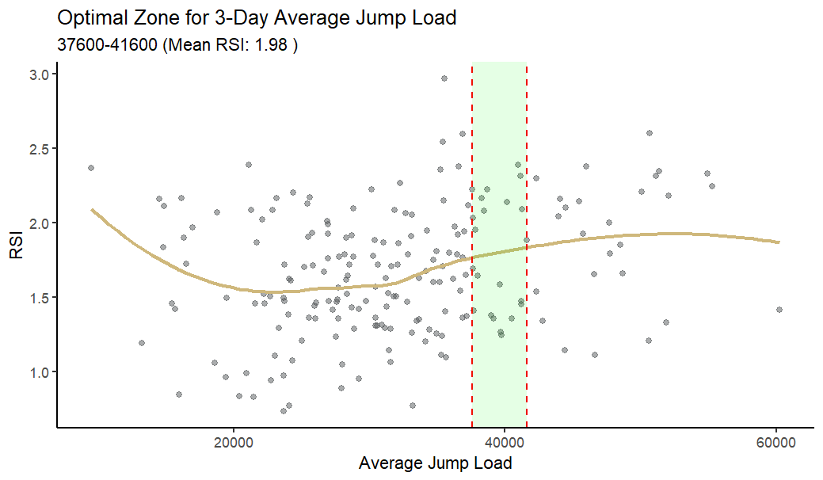
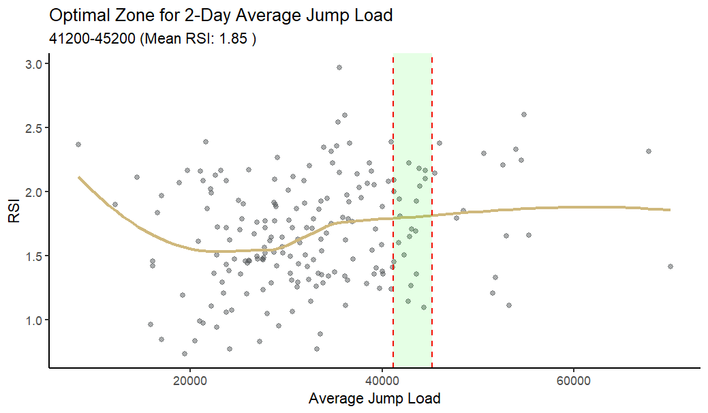
Jump Load
Previous Load
Notes:
Establishing baselines
Doubled tests performed

Slide 19
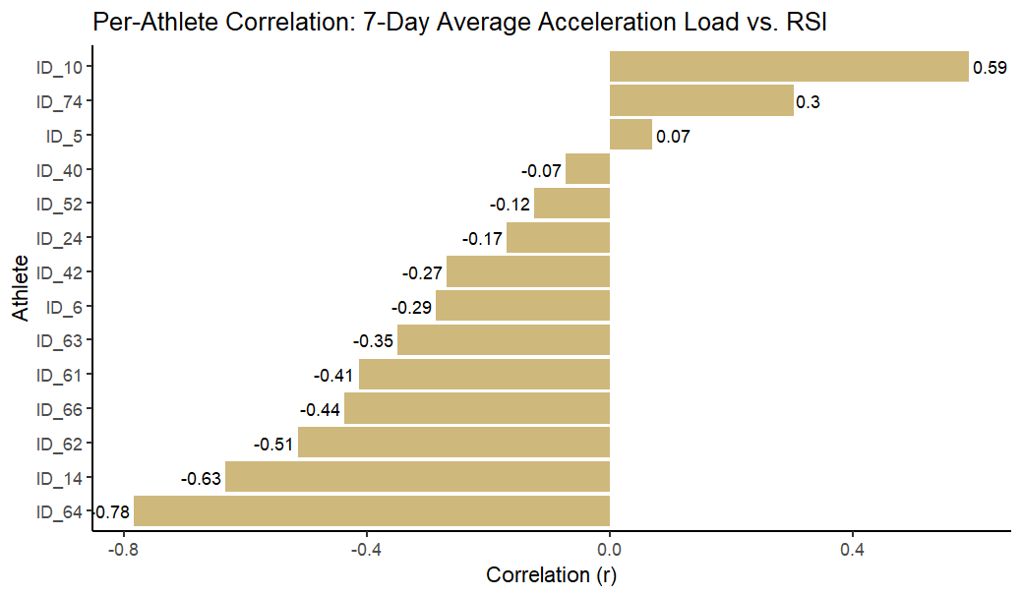
Previous Load
*
Notes:
Establishing baselines
Doubled tests performed

Slide 20
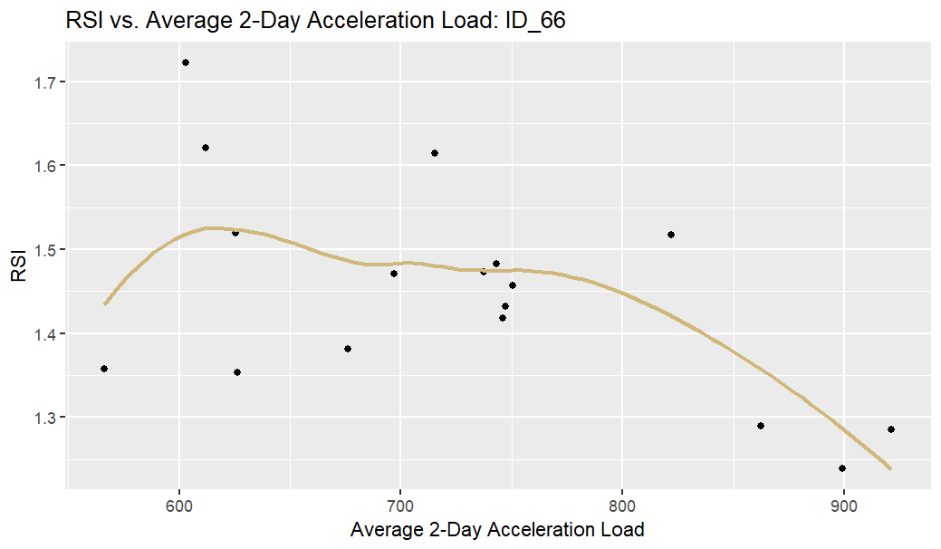
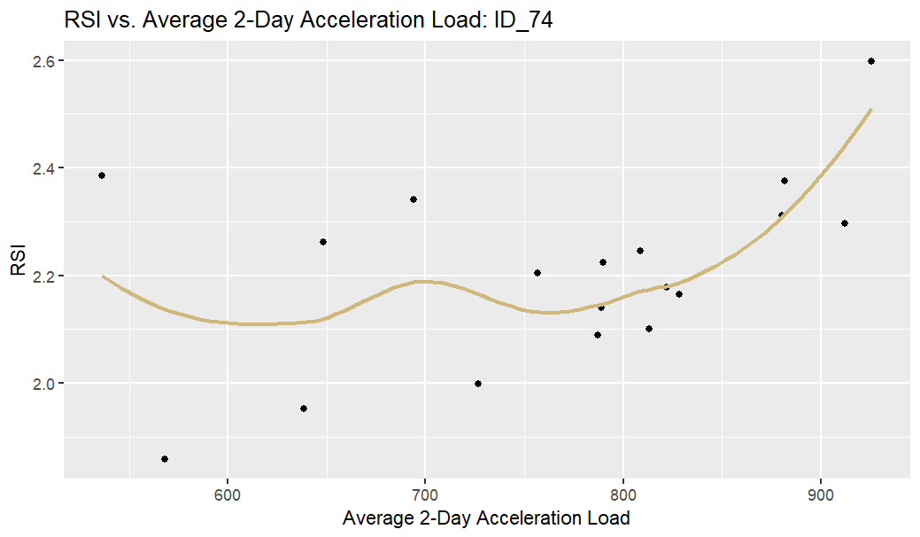
Previous Load
Notes:
Establishing baselines
Doubled tests performed

Slide 21
Final Thoughts
Previous Load
Acceleration load showed the strongest and most consistent. relationship with RSI, especially over the 7-day and 3-day periods.
Higher 7-day average acceleration load → lower RSI.
Higher 3-day average acceleration load → higher RSI.
Jump load relationships were inconsistent.
Actionable Insights:
Optimal Acceleration Load Zones:
785-835 (2 and 3-day windows)
815-865 (7 day windows)
* Athlete-specific results varied widely.
Notes:
Establishing baselines
Doubled tests performed

Slide 22
What is each athlete's variation in RSI? What is a meaningful change in RSI for the team and for the athletes?

Slide 23
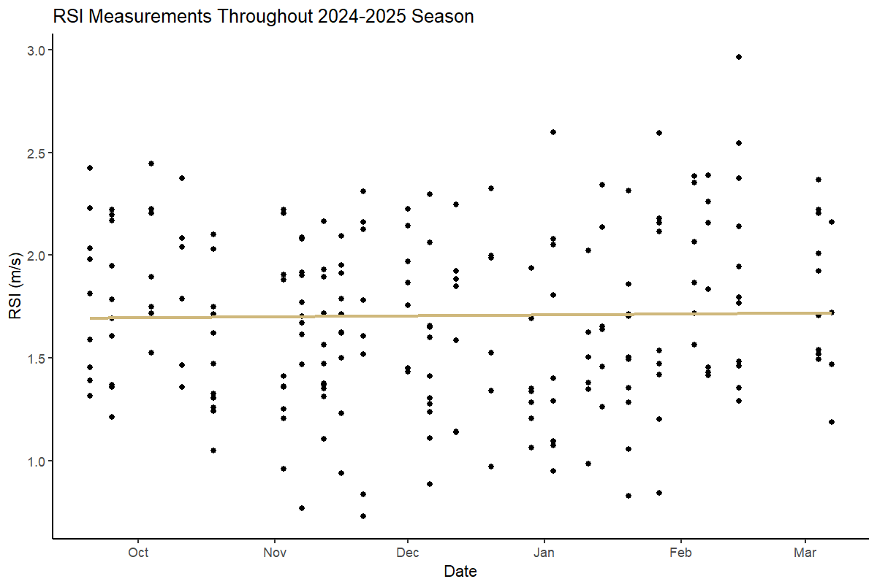
Variation and Change
Notes:
Establishing baselines
Doubled tests performed

Slide 24
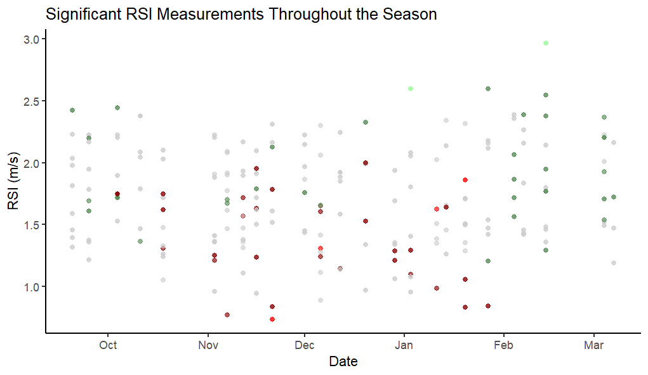
Variation and Change
Notes:
Establishing baselines
Doubled tests performed

Slide 25
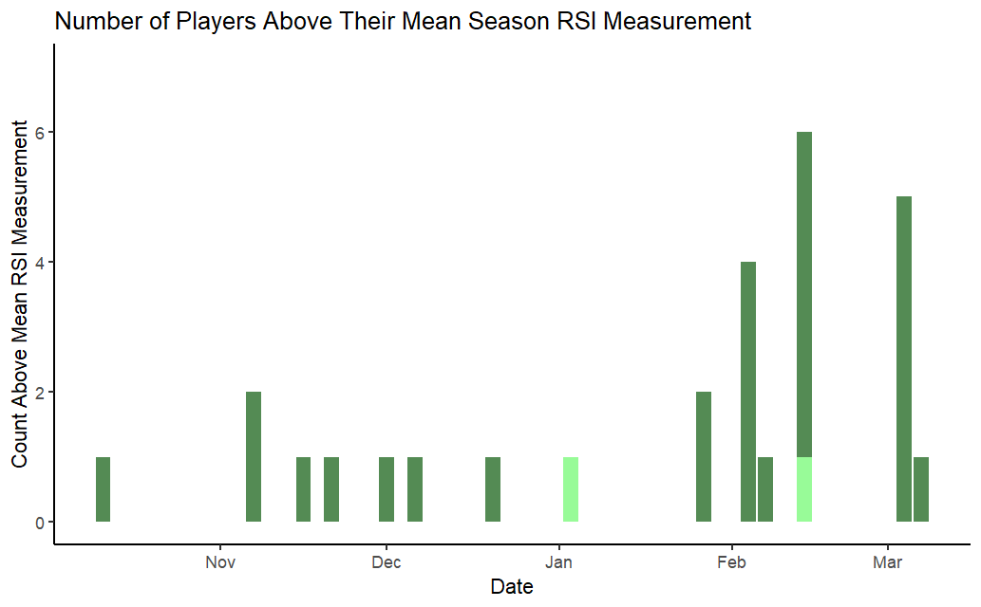
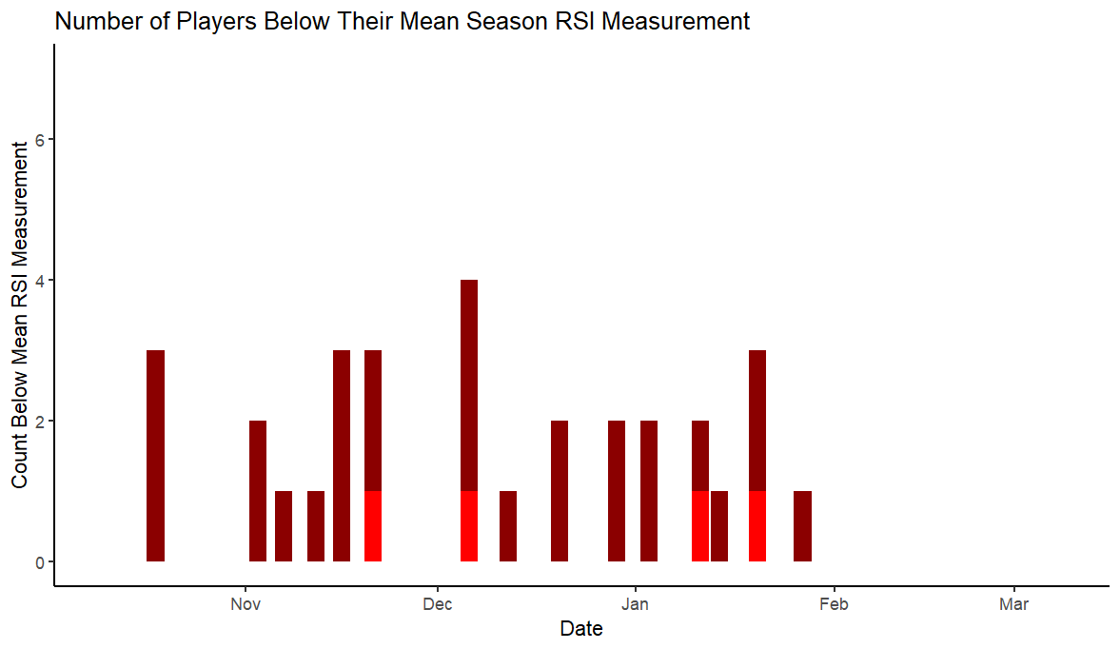
Variation and Change
Notes:
Establishing baselines
Doubled tests performed

Slide 26
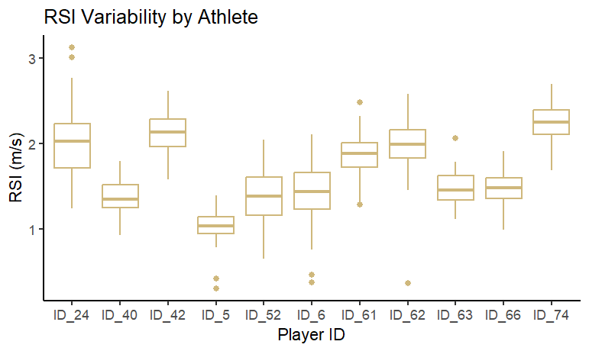
Variation and Change
Notes:
Establishing baselines
Doubled tests performed

Slide 27
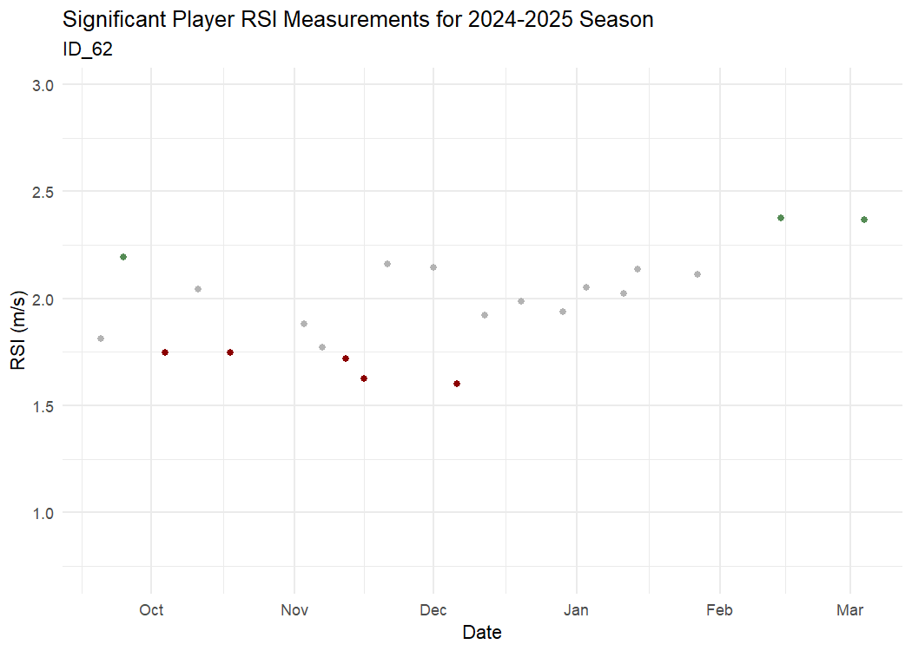
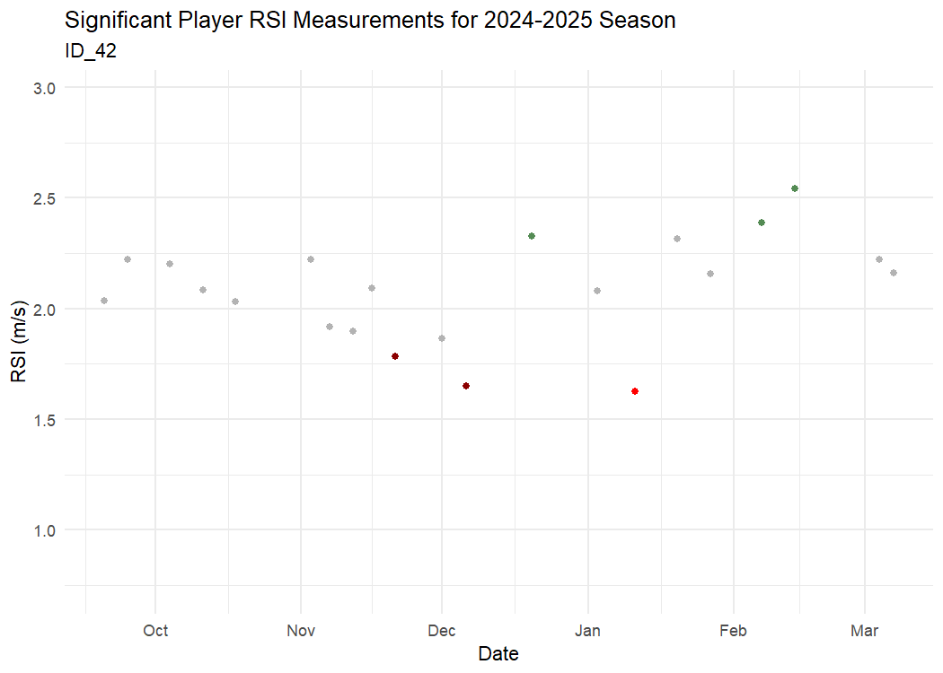
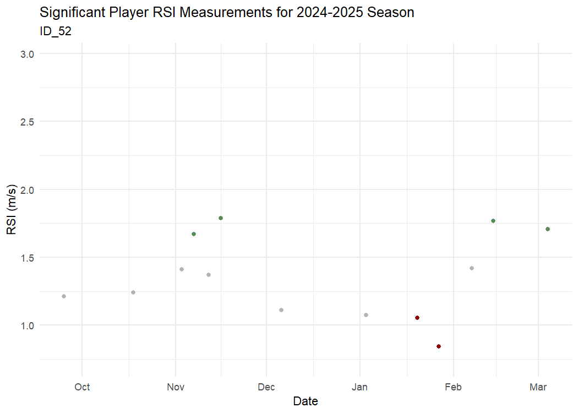
Variation and Change

Slide 28
Final Thoughts
Variation and Change
There's no clear way to quantify a change in team RSI
Player RSI measurements do not vary in similar ways
When players have a significantly low RSI, tend to have another significantly low measurement in the following days to week
When players have a significantly high RSI, tend to have another significantly high measurement in the following days to week
Notes:
Establishing baselines
Doubled tests performed

